Slide 1
DATA 621 HW3
Keeno Glanville

Slide 2
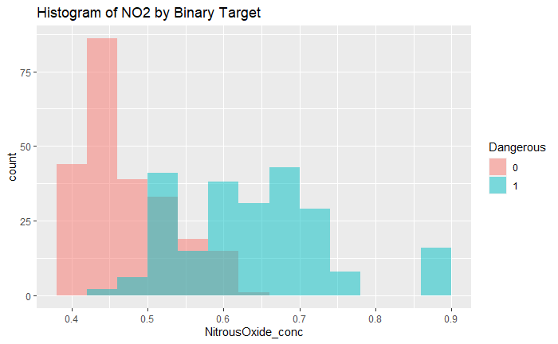
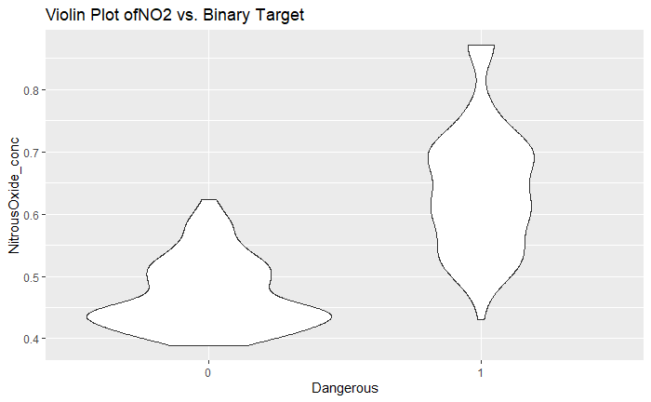
DATA EXPLORATION
I first explored the data through applying a point biserial correlation to the target variable. With this I was able to deduce the most influential variables on our measured outcomes. We then plot the most influential variable which was Nitrous Oxide Concentration. This was quite surprising.
Histogram
Violin Plot

Slide 3
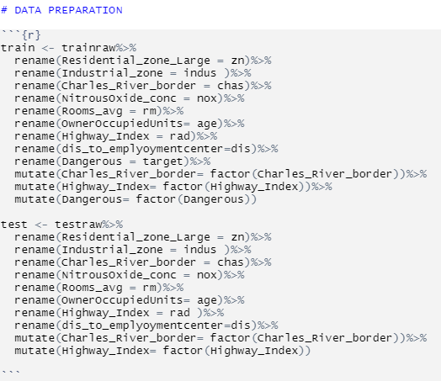
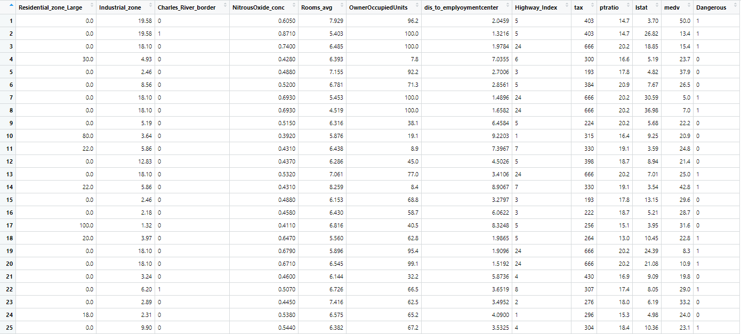
DATA PREPARATION
Preparing the data was quite simple. It involved really renaming the columns to fit my understanding as well as correctly labelling each column with its type (factor, numerical, etc.)

Slide 4
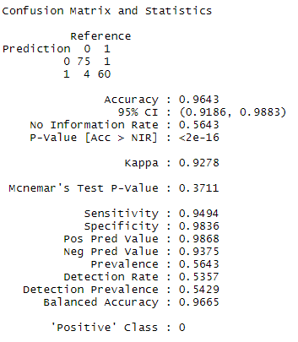
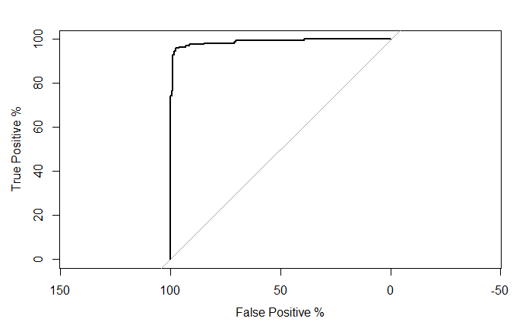
MODEL BUILDING
The model utilized was a logistic regression which proved to initially show an overfit to the data. This could be due to the insufficient observations within the dataset. The regression was initially done factoring all variables, then removal of categorical variables, finally a scaled and one-hot encoding model.

Slide 5



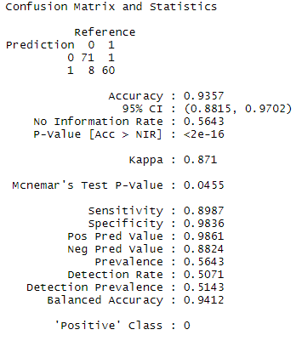



SELECTING MODEL
I wanted to chose a model that was accurate but didn't seem to be overfitted. The way I accomplished this was by scaling the numerical variables and one-hot encoding the categorical variables. The test set provided didn't have values I could use for the prediction ROC and AUC curve so I instead subset the training data.

Slide 6
Appendix
https://github.com/kglan/MSDS/blob/03829122632aef9e839d0130ffa23c8cf47ea680/DATA621/HW3/HW3.Rmd
https://github.com/kglan/MSDS/blob/03829122632aef9e839d0130ffa23c8cf47ea680/DATA621/HW3/HW3.pdf

